Slide 1

Facial recognition using python
A Project by: T Shankar Sai & S Vigneshwaraan

Slide 2
Agenda
Problem statement
Implementation analysis
RESOURCES

Slide 3
Problem statement
Security and Surveillance
Authentication and Identification
Time and Attendance Tracking

Slide 4
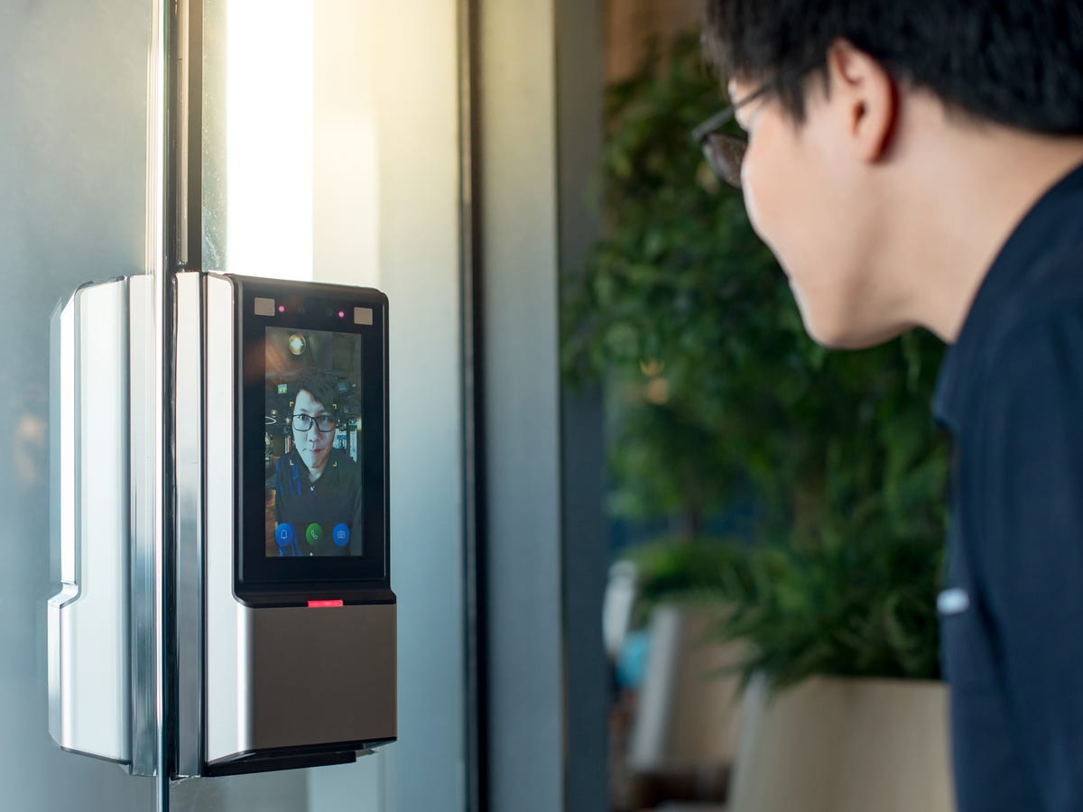
Security and surveillance
The World is moving towards advanced level of technology.
Facial recognition is the next level of security
It doesn’t require any ID card or help of some other device to authenticate access
It scans face deeply, so no other person than you can get access it
It’s precision can be very well increased by training the model

Slide 5

Authentication and identification
Mobiles use 3D face mapping to authenticate the user
They scan user face using infrared light and image capture
It also works in dark places, due to pre-trained 3d face model
It should be update for 3-5 years once, So that machine identifies your facial changes quickly

Slide 6
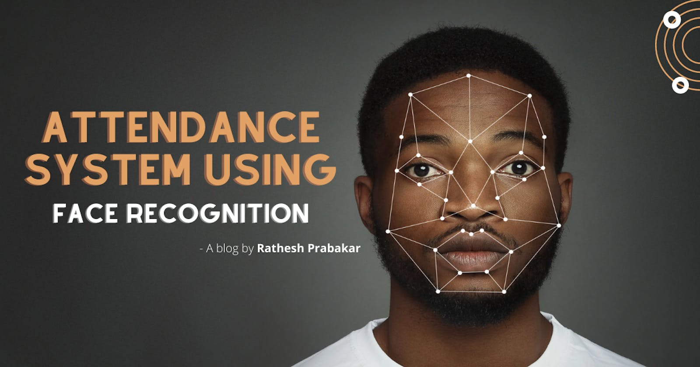
Time and attendance tracking
Modern schools and corporates use face recognition to take attendance
The worktime of employees is calculated using the cameras in the office which captures their movements and updates their desk time
This is fast and secure

Slide 7
implementation of solution
Data Collection
Preprocessing
Model Training
User Interface
Decision Threshold
Face Detection and Recognition
Testing and Evaluation
Deployment
Notes:
Preprocessing: Image formatting-Resizing-Train and Testing
Model Training: Machine Learning Algorithm-Support Vector Machine(SVM)-Deep learning model(CNN-)
Face dect: Detects faces as input-image/video stream-Single Shot Detector(SSD)
Decision Threshold: Determine when to accept result or unknown
User Interface: user friendly web app
Testing/Evaluation: Accuracy/Performance/Potential Biasis
Deployment: Applications of Facial Recog.6

Slide 8
resources
1. Pre-trained Model
2.Software Libraries
3.Computational Power
1.Facial Database
2.Training data
3.Testing data
1.Facial Detection Algorithm(AI)
2.Data Processing Tools

Slide 9
Conclusion
CONCLUSION
Facial recognition technology presents a myriad of opportunities and challenges. While it offers significant benefits in security, convenience, and crime prevention, careful consideration of privacy, ethics, and regulation is essential to strike a balance between technological advancement and protecting individual rights. With responsible implementation, facial recognition can revolutionize various industries and contribute positively to society.

Slide 10
THANK YOU!

